Slide 1
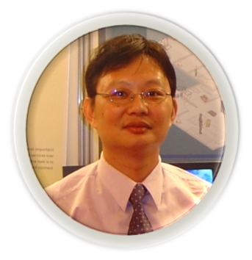
Python程式與資訊安全
Python-CTF: Python實戰CTF
使用Python求解CTF實戰課

Slide 2
Crypto 102
School CTF 2015: affine-cipher-100(教)

Slide 3
Crypto_103_affine-cipher
School CTF 2015: affine-cipher-100(教) 150 https://github.com/BurningMarshmallow/CTF/blob/master/affine_solve.py
import string
s = string.ascii_lowercase # a-z
s += '_'
d = {}
for c in range(len(s)):
d[s[(c*4 + 15)%27]] = s[c]
ciphertext = 'ifpmluglesecdlqp_rclfrseljpkq'
s1 = ''
for x in ciphertext :
s1 += d[x]
print s1

Slide 4
Crypto 101
RC3 CTF 2016 : salad-100
20

Slide 5
import string
caesaralpha = "abcdefghijklmnopqrstuvwxyz0123456789"
def caesar(input_string, rot):
output_string = ""
for i in range(len(input_string)):
if input_string[i].isalnum():
idx = (caesaralpha.find(input_string[i]) + rot) % len(caesaralpha)
output_string += caesaralpha[idx]
else:
output_string += input_string[i]
return output_string
enc = '7sj-ighm-742q3w4t' # encrypt data
for i in range(len(caesaralpha)):
print caesar(enc, i)

Slide 6
'rc3-2016-romangod'.upper()

